Slide 1
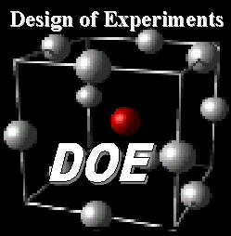
Design of Experiments
Presenter: Chris Hauser
860 Greenbrier Circle
Suite 305
Chesapeake, VA 23320
www.avwtech.com
Phone:
757-361-9011
Fax:
757-361-9585
AVW Technologies, Inc
Notes:
Good afternoon
We are here to discuss how to manage the expectations of your clients and project leaders in regards to Design of Experiments.
This is a relatively new field of statistical planning and predictive analysis within the Test and Evaluation community. And as with any new “tool” we have to learn what that tool will and will not work on.
AVW is a veteran owned company providing Professional Engineering Services, Test and Evaluation Support, and Shipbuilding Engineering Management Consulting.
Our efforts to date have primarily been focused on surface ship acquisition, from Design through Production and Test and Lifecycle Management.
AVW is also a recognized leader in the use of Integrated Product Data Environments and Digital Product Models to support Ship Acquisition, as well as the use of Modeling and Simulation technologies to support Design, Production, and Test and Evaluation. We are growing our own expertise in DOE, most of our staff have been through the Air Force or commercial training programs.

Slide 2
Why Test?
“Testing is a critical element of systems engineering, as it allows engineers to ensure that products meet specifications before they go into production. The testing literature, however, has been largely theoretical, and is difficult to apply to real world decisions that testers and program managers face daily. Nowhere is this problem more present than for military systems, where testing is complicated by of a variety of factors like politics and the complexities of military operations. Because of the uniqueness of military systems, the consequences of failure can be very large and thus require special testing considerations, as program managers need to make absolutely sure that the system will not fail. In short, because of the high stakes consequences associated with the development and use of military systems, testers must adjust their testing strategies to ensure that high stakes consequences are adequately mitigated.”
Excerpt: Testing and Evaluation of Military Systems in a High Stakes Environment, Raphael Moyer, Abstract submitted to MIT, June 2010
Notes:
As I said before, DOE has been getting a lot of press within the Acquisition community as the next best thing to come along.
The costs of modern acquisition are climbing and we all have to be good stewards of the government funding we receive. That includes the test community of course. Even though testing, from the developmental end throughout the life cycle amounts to less than 10% it is still incumbent on use to spend that amount wisely. Likewise, as the slide says there are high stakes consequences to not adequately testing the systems that are entering or are in service. We owe the taxpayer the proper and prudent use of the funds, to the warfighter, we owe our very best efforts, to ensure the system or systems are fully capable and ready to support them.
As the Memorandum of Agreement between Director, Operational Test and Evaluation and the service Operational Test Agencies stated
“Experimental design further provides a valuable tool to identify and mitigate risk in all test activities. It offers a framework from which test agencies may make well-informed decisions on resource allocation and scope of testing required for an adequate test. A DOE based test approach will not necessarily reduce the scope of resources for adequate testing. ….Utilizing the discipline of DOE in all phases of program testing from initial developmental efforts through initial and follow-on operational test endeavors affords theopportunity for rigorous systematic improvement in test processes.

Slide 3
DT & OT
- Why Test?
- Test to learn and bound capabilities
- Does system meet capability requirements?
- What is actual system performance?
-Why learn?
- How is system best employed?
- To enable program decisions
- Develop best employment Tactics, Techniques and Procedures
Notes:
We all know why we have to test the systems. We test to make sure the capabilities desired and described are actually me. The critical technical parameters are fulfilled, the critical operational issues were addressed. And most importantly, to make sure we deliver what the warfighter needs, when they need it and it is fully capable of supporting mission accomplishment.
To that end we have to test to mitigate risk during development, we have to test the systems in a realistic and meaningful way to ensure the requirements are met and to quantify and qualify the system is operationally effective, suitable and survivable. The warfighter needs good equipment, not something that he or she has to coddle to get it to do its function.
We also need to understand the best way to use the system, to explore the possible tactical implications, techniques and procedures. The threat is constantly evolving and we have to meet the new requirements this change means. Here is an example from Jay London “I'm convinced my cockroaches have military training, I set off a roach bomb - they diffused it. “ While funny, its true. The threat evolved and the roaches found a way to counter it. So to, we as testers have to adapt to the new environment. We have to show how we are going to test, show how this will contribute to a better understanding of the system. We have to diffuse the bombs too. We need to use our resources well and still deliver a defendable analysis of system capabilities.

Slide 4


DOE = Another Tool
Focus on the use Design of Experiments (DOE) within
the Test and Evaluation (T&E) community.
Allows the prudent tester to manage expectations of
stakeholders as to how DOE can be applied to system-
specific testing
Notes:
Design of Experiments is a tool that does aid the test community….if used as it is intended. It is not the end all, be all of predictive analysis, nor is it any better for post event analysis. Like the label says, use as directed. Don’t self medicate.
There are a lot of executive seminars that talk about DOE and what it can do. They give you a taste of what DOE brings to the table, but they don’t go into a lot of detail. DOE requires the user to know their system, it requires the involvement of Subject Matter Experts and it is an iterative process.
The best way to use DOE is from the start of a program, just as we start the Integrated Process Teams for Training, Logistics, Training, etc, we have to start using DOE as the systems engineering process starts. DOE works best as a process. In the past we have attempted to improve plans and reports by the review cycle. This is similar to inspecting in quality of work on a factory line, there is a lot of scrapped attempts and rework. To effect process output improvement we need to change the process.
DOE can change the seven habit of ineffective testing. 1. Stats are for wimps and simps. 2. Calling in the analyst/statistician only after the test is over 3. Use the same number of samples from the last successful test. 4. Assume the process is well understood and miss problem decomposition. 5. Fail to randomize runs, 6. Fail to consider interactions. 7. Minimize factors considering in order to get multiple replicates of each test condition.
Remember, the tool is only as good as the mechanic.

Slide 5
7 Habits of Ineffective Testing
1. Stats are for wimps and simps.
2. Calling in the analyst/statistician only after the test is over
3. Use the same number of samples from the last successful test.
4. Assume the process is well understood and miss problem
decomposition.
5. Fail to randomize runs,
6. Fail to consider interactions.
7. Minimize factors considering in order to get multiple
replicates of each test condition.
Notes:
Design of Experiments is a tool that does aid the test community….if used as it is intended. It is not the end all, be all of predictive analysis, nor is it any better for post event analysis. Like the label says, use as directed. Don’t self medicate.
There are a lot of executive seminars that talk about DOE and what it can do. They give you a taste of what DOE brings to the table, but they don’t go into a lot of detail. DOE requires the user to know their system, it requires the involvement of Subject Matter Experts and it is an iterative process.
The best way to use DOE is from the start of a program, just as we start the Integrated Process Teams for Training, Logistics, Training, etc, we have to start using DOE as the systems engineering process starts. DOE works best as a process. In the past we have attempted to improve plans and reports by the review cycle. This is similar to inspecting in quality of work on a factory line, there is a lot of scrapped attempts and rework. To effect process output improvement we need to change the process.
DOE can change the seven habit of ineffective testing. 1. Stats are for wimps and simps. 2. Calling in the analyst/statistician only after the test is over 3. Use the same number of samples from the last successful test. 4. Assume the process is well understood and miss problem decomposition. 5. Fail to randomize runs, 6. Fail to consider interactions. 7. Minimize factors considering in order to get multiple replicates of each test condition.
Remember, the tool is only as good as the mechanic.

Slide 6
Some History
DOE has had application in industry since the early 1900’s
  Profound impact in agricultural science – Guiness
  brewing
  Successfully applied in the brewing and process
  industries – contact lenses
- Success in many industrial applications for
process improvement
DOE works, if applied used first and correctly
Notes:
Design of Experiments originated in the field of agricultural studies in the 1930s by R. Fisher, building on W.T. Gossett’s work at Guinness Brewery. Anything that starts with a beer is by definition good.
The Air Force, 53rd Wing is adopting it as a valid means of designing, conducting and analyzing operational tests – including F-22. 59th TES is the leader in DOE. Dr. Greg Hutto , a recognized expert in this field is leading the Air Force’s efforts. There is a great training curriculum available to government and contract personnel to become more familiar with DOE. There are other seminars, webinars and exportable training to build familiarity.
DOE used to interrogate process, and improve knowledge of how the process works. It is used to interrogate the process and improve our knowledge of how the process works. The goal is a systematic method to efficiently and unambigiously improve the outcomes.
Compared to other systematic methods, DOE designs do yield better process understanding, can be planned and analyzed faster, and may save resources through judicious application.

Slide 7
The Perpetual Quandary – How much is enough?
- 4 challenges of any Test
- How many / depth of test
- Which points / breadth
- How to execute / order of testing
- What conclusions
Related to how much risk we’re willing to take
False positives and false negatives = Wrong answers
Which points within the design space to test and
what’s good?
Excerpt: USAF 46th Wing DOE course
Notes:
As testers we all face the four basic challenges. How many articles for test. And with that how many reps can we do? We can’t test all parts of the operational envelope, as much as we would like to.
Along with that are the points we should test, and the ones we would want to. How far will our resources reach?
In what order do we test? And what happens if we get a result that was unexpected. Do we go to the hard end of the envelope first, or last?
We have to interrogate the process, using DOE to understand the system, its capabilities, what factors will affect it and affect each other. We can’t afford to test the system, then find out we were wrong in our assumptions. The tester has to know the system, the influencing and influence-able factors, what can and can’t be controlled and how to account for it. We want to start with a workable and testable hypothesis. We have to know the power and the confidence factor we are seeking. Very real budget constraints will not tolerate starting over from ground zero.
Understand you will never get all the resources you want. The world of unlimited test articles never existed and we have to husband what we got. As DOT&E said in their 2009 T&E Resources Report The operational testing environment continues to become more complex as a result of advances in weapon and sensors, new threats, new methods of employing current systems, and the proliferation of advanced technology. Service budget projections will further stress investment in and support of test resources and staffing at test centers and activities.

Slide 8
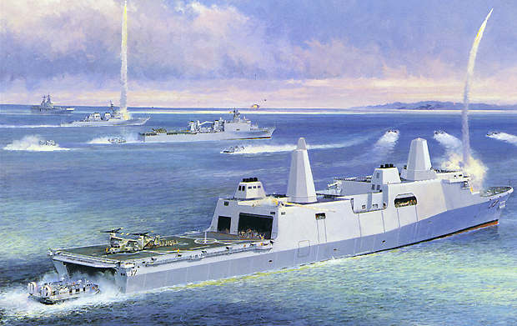
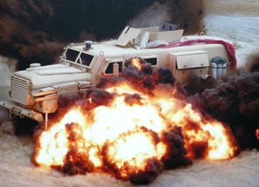
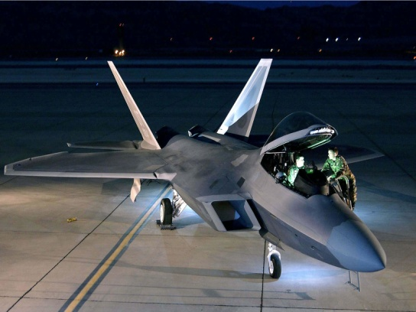
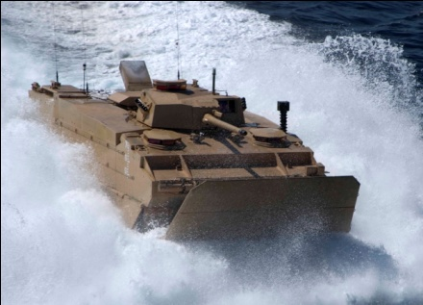
Tester’s Challenge
- Challenges of Testers
- Time to execute the test
- Resources to support the full scope of planned test
- Funding
The best test may go unfunded while the “worst” test gets funding support
Notes:
We just talked about funding, or the lack of it for testing resources. The other two challenges listed are just part of that. We never have all the time needed to test. Take a ship test as an example. Even when a carrier goes out for testing of one system there are so many other things going on concurrently. The engineers need to do drills, the flight deck crew has CQs and DLQs to complete, General Quarters training for the ship, etc. Sometimes we are forced to take what we can get, when we can get it. I am sure that many of you have gotten up to run your testing in the middle of the night since that was the only time available. Or your test windows have only been 2 hours when really 8 hours was needed.
All of our resources are precious, time, assets, people, resources, and data. DOE helps us to narrow down the scope of testing to the pertinent areas, to identify and quantify the areas that have to be tested. This process shift allows us to get to the heart or the edge of the envelope quickly and accurately. When applied properly we know where we need to be in the test matrix, we can quickly analyze the data from the test we just ran and if necessary rapidly replan.
This, of course, presumes we have incorporated DOE and done the preplanning required. DOE is not something you pick up at the last second and try to fit it to the problem. It is a process shift. Its not an 11th hour addition.

Slide 9
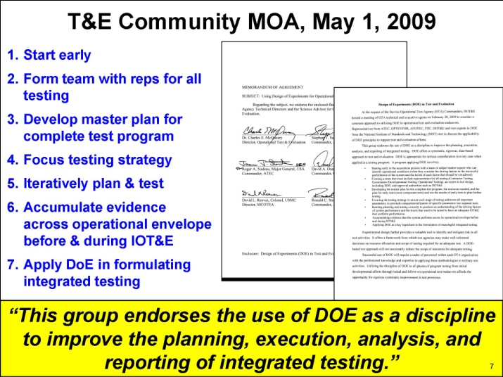
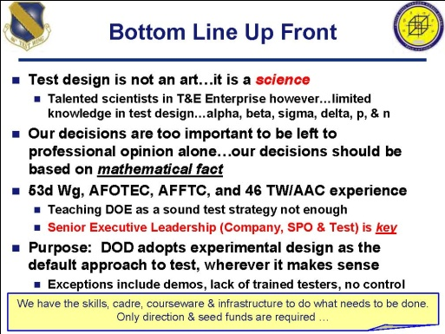
DOE
Another tool in the tool box!
- Mandated use in Gov’t T&E
- DOT&E requires DOE in Operational Testing
- Recent DDT&E guidance on Developmental
Testing – They want to see a framework also
- Service OTAs have Joint MOA naming DOE as a
best practice
DOT&E has rejected TEMPS based on inadequate DOE
Notes:
The senior leadership in Test and Evaluation, both developmental and operational recognize the value of DOE when properly applied.
As I stated before, the MOA says “Experimental design further provides a valuable tool to identify and mitigate risk in all test activities. It offers a framework from which test agencies may make well-informed decisions on resource allocation and scope of testing required for an adequate test. “ And that is of course the goal of every test. An adequate test. DOE, starting from the beginning of the systems engineering process, and continuing on into developmental and operational testing will enable us to meet that mandate.
The Navy OTA has taken this a step further with Mission Based Test Design and the Integrated Evaluation Framework. Both of these are invested in process decomposition and identification of factors, tasks, and attributes, all core tenets of DOE.
Test design has to move from the realm of art to science and decisions have to be based on mathematical fact. DOD will adopt DOE as the default approach…… where it makes sense.

Slide 10
Observation by a Practitioner
- “At this point in history, using DOE simply means laying out the primary factors that affect the response variable in at worst a notional design (and at best a design that one could readily use with proper resources and leadership support)”
Constant Factors / Conditions
Held constant for selected tests due to limitations, test objectives, etc.
Dr. R. McIntyre Feb 2010
Control Factors / Conditions (Controlled run by run or held constant depending on design)
Response Variable(s)
(Selected Attributes)
PROCESS
(Vignette Tasks &
Test Data Collection)
Nuisance Factors / Conditions (measurable & not measurable)
COTF DOE Process Brief Jul 2010
Notes:
DOE is not new, however its application in military testing is. As with any new tool, trend, process it takes a while to find the niche for it to fill. Within DOD there is a mandate from DOT&E as well as the OTAs, but that is guidance, now comes the tactics, techniques and procedures for using this new thing called Design of Experiments. While some of you have received training in this, you are still wrestling with how it works and how to apply it. As noted, from one practitioner, we are in the ground stages within the military. Some are further ahead than others. An example is the USAF testing community. They have led the way in applying DOE to operational testing. The Navy is closing ground on this though. Some preliminary work has been done applying DOE to CVN 78 Sortie Generation Rate, Run numbers for the PRA Testbed and LHA 6. The Navy’s OTA has built a process around DOE and Mission Based Test Design (engineered by AVW) called the Integrated Evaluation Framework.
We are in the early stretches of this road course. The car and driver are still getting used to the road and its curves. We are learning how to identify and quantify the factors; how they affect the response variables, and developing a notional test design. There is still room for development and process refinement.
We also have to learn to manage the expectations of the senior leadership in regards to DOE. Both within our organizations and across the acquisition structure as a whole. DOE can do a lot, if properly applied. And that means at the start of a system’s development. Playing catch up is difficult and as mentioned before bringing the analyst in after the fact does not help the test that is already done.

Slide 11
DOE & Implications for Integrated Testing
Where does application of the DOE best fit?
  Best applied as a continuum beginning early in the systems
  engineering process and carried through operational
  testing
- Early and iterative application ideal
A single test may be insufficient to observe all key factors of
performance. DOE is the difference between testing a “black
box” and a system-of-systems
Best if used early and throughout the process
Notes:
The tester, the analyst and the SME have to work in concert up front, before the test is planned even. We have to know the system process, what factors influence it, which of those are controlled and which are uncontrolled. How those factors will affect the response variable. Of course we won’t be able to know all of this up front. This is an iterative process. With every test we learn more about the system and in the post analysis we can learn how to improve the follow on tests.
Applying DOE in a continuous fashion from inception to OpEval and beyond enables us to learn from the tests and how to fashion/shape the successive events. No one test will answer all the questions of course, if that were true we wouldn’t need DOE. We have to alter the variables and assess the changes in the response variables. Will we answer all the questions in one round? Doubtful, but we have data, we have a test matrix, we know the power and confidence factor and we will be able to narrow the testing environment to those relevant factors.
We will be able to look inside the black box rather than checking the gozintas and gozouttas and trying to figure out what happened inside that former enigma.
One caveat though, DOE will help you develop the test and analyze the results, but it is only as good as the inputs that are given up front. We have to be cautious and always anticipate false positives or false negatives. We develop, execute, analyze and refine our testing.

Slide 12
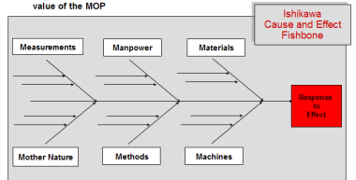
Generic DOE Process
Planning: Define Process, Potential Factors, and Response Variables
Select Response Variables and Nuisance, Constant, and Control Factors
Select Appropriate Design Points
Populate
Test Matrix
Conduct Analysis, Develop Regression Model
Validate (Confirmation Runs, Check Assumptions in Residuals)
Graph Results,
Draw Conclusions
Actual | Predicted | Valid
0.315 | (0.30 , .33) | ✓
COTF DOE Process Brief Jul 2010
Notes:
Here is a representation of what we have been talking about. You can see the DOE process from start to finish. As I keep reiterating, it starts with the planning and process definition. Factor selection and response variables are identified here.
Then we go on to the actual variables, what is nuisance or noise within the testing. We have to be cognizant of the fact we are looking for those spikes that come up out of the noise of the test. It is a Signal to Noise Ratio problem, for those of you familiar with ASW, you are looking for that telltale return echo.
Another point to stress here, is to bring in a DOE practitioner early. They will help you select the appropriate test design and the points to test. There are software programs out there that will help you do this. However, remember, garbage in, garbage out. You want to maximize your resources and getting a DOE person in early will save you. You want your tests to be meaningful.
The test matrix is populated and you analysis where you need to test. Run the test, get the raw data, graph the result and draw conclusions. You will see where you need to concentrate the remainder of your test resources. The results you get will be quantifiable, repeatable, and defendible.

Slide 13
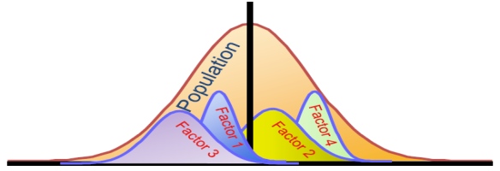
DOE Starting Points
Understand the system process being evaluated
Use of a skilled DOE practitioner and knowledgeable SMEs highly
recommended
A design approach for one system may
not work for another system or
system of systems
Given time and available resources, DOE can provide the decision maker
the level of risk associated with each test design
Design vs Demonstration
Worst case scenario, DOE will at least point you
to the most useful demonstrations to observe
Notes:
Okay, well we are at the get off the stage slide. To summarize
Understand the system being evaluated.
Start DOE at the beginning, continue it in an iterative fashion, updating it with insights you discover about the process, the factors and the response variables.
Know what you don’t know. If you don’t have the DOE skills or a Subject Matter expert available, realize that a cost to get them involved early will save you a lot in the long run.
Just as one model is not suitable for all applications the same is true with DOE. An approach for one system may not work for another system or process. Not everything is a nail so don’t think DOE is the only hammer.
Get leadership buy in to the process and ensure they know that one answer is not THE answer.
Understand that a designed test is different than a demonstration. A demonstration is one part of a test, it is not the whole test series in one event. You may only get one live demonstration so maximize the data you can get and feed it into your design.
DOE is not the ultimate answer to all the questions, but it will show you where you need to ask the questions.
DOE will help you use the scarce resources you have available in a focused fashion.
Analyze the results of each test and use them to improve the next test.
Thank you for your time and attention. I will be available for questions afterward.
Good luck and good testing.

Slide 14
Design of Experiments
Presenter: Chris Hauser
860 Greenbrier Circle
Suite 305
Chesapeake, VA 23320
www.avwtech.com
Phone:
757-361-9011
Fax:
757-361-9585
AVW Technologies, Inc
Notes:
Good afternoon
We are here to discuss how to manage the expectations of your clients and project leaders in regards to Design of Experiments.
This is a relatively new field of statistical planning and predictive analysis within the Test and Evaluation community. And as with any new “tool” we have to learn what that tool will and will not work on.
AVW is a veteran owned company providing Professional Engineering Services, Test and Evaluation Support, and Shipbuilding Engineering Management Consulting.
Our efforts to date have primarily been focused on surface ship acquisition, from Design through Production and Test and Lifecycle Management.
AVW is also a recognized leader in the use of Integrated Product Data Environments and Digital Product Models to support Ship Acquisition, as well as the use of Modeling and Simulation technologies to support Design, Production, and Test and Evaluation. We are growing our own expertise in DOE, most of our staff have been through the Air Force or commercial training programs.

