Slide 1
Design of Experiments and the Probability of Raid Annihilation (P_{RA}) Testbed
Presenter: Richard Lawrence
860 Greenbrier Circle
Suite 305
Chesapeake, VA 23320
www.avwtech.com
Phone:
757-361-9581
Fax:
757-361-9585
AVW Technologies, Inc
Notes:
Design of Experiments (DOE) offers the opportunity for efficiency in test execution and to gain insight to the operations of complex systems. The current AAW SSD PRA metric is not DOE friendly in that the outputs of the Testbed do not lend themselves to straightforward statistical modeling. In this talk, a simple definition of DOE is given with ideal types of data preferable for statistical analysis. An overview of the PRA Testbed factors and outputs is described from the perspective of developing a statistical model. Specifically, isolation of factors is difficult because each environment file (radial, time, etc.) has a confluence of factors—sea state and wind direction are set, but RF propagation from temperature, pressure, and humidity are not. Land clutter is a function of radial, and is somewhat dependent on RF propagation. Thus, each scenario includes variation of several variables which are not controlled. The binary nature of the Testbed output is also difficult from a statistical analysis standpoint because traditional statistical measures like variance and error cannot be calculated. Finally, an example of the Testbed's non-determinism is given which adds a 'noise' element to the analysis. For each factor and the output, a potential solution to the challenges for statistical analysis is presented. For example, categorization of the environment for each radial, and development of miss distance to measure the accuracy of the overall system. Adoption of these methods would render additional information about the ship's self-defense system, and provide more insight with respect to its performance than the simple PRA metric currently does.

Slide 2
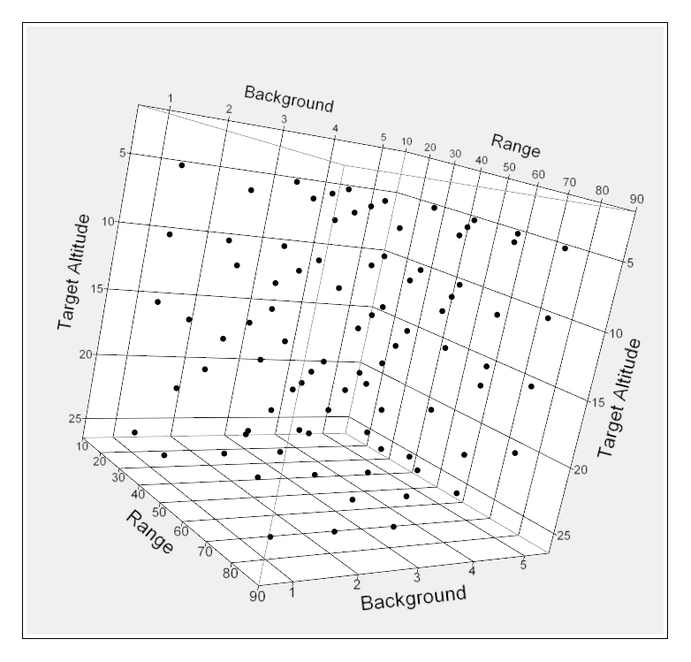
Design of Experiments and P_{RA} Testbed
Introduction
Design of Experiments (DOE) offers the opportunity for efficiency in test execution and to gain insight to the operations of complex systems. The current AAW SSD P_{RA} metric is not DOE friendly in that the outputs of the Testbed do not lend themselves to straightforward statistical analysis. This is an overview of the challenges to executing a serious DOE process on the P_{RA} Testbed and proposed methods to solve these challenges.
Presentation Outline
Usable definition of DOE
Background
Challenges
Levels of Factors
Scoring
Non-Determinism
Basic Steps
Conclusion
AVW Technologies, Inc

Slide 3
Principles of DOE
Create a statistical model of a system based on identified factors and measured outputs.
Purposefully vary input (factors) and correlate with outputs.
X1
Y1
X2
Inputs
PROCESS
X3
Outputs
Y2
X4
AVW Technologies, Inc
Notes:
Testbed is not entirely a black box, we know a lot about how it works, so we’re not starting from scratch.

Slide 4
Principles of DOE (2)
Run matrix is developed from several techniques to establish a ‘sample space’.
Different from ‘One Factor at a Time’ testing because variables are changed several at a time and effects are separated in the analysis phase.
Through analysis of outputs, identifies and quantifies effects of various factors
Run | X1 | X2 | X3 | X4 | Y1 | Y2 | Y_{ave} | σ_{Y}
1 | + | 0 | 0 | 5
2 | - | + | + | 2
3 | - | 0 | + | 2
n
AVW Technologies, Inc
Notes:
Efficiencies gained in varying multiple inputs in a ‘designed’ fashion, versus ‘One Factor at a Time’ Testing.
Explain ‘categorical’ variables. Example, Ship RCS.

Slide 5
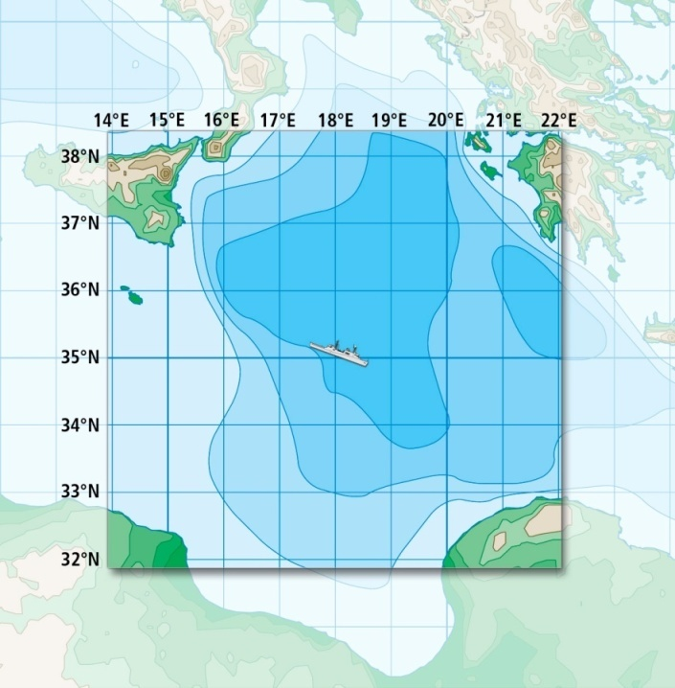
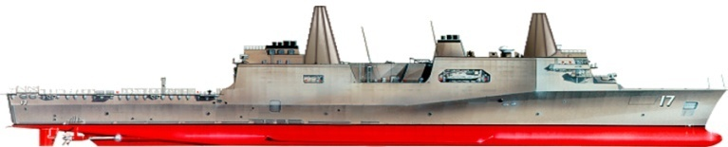
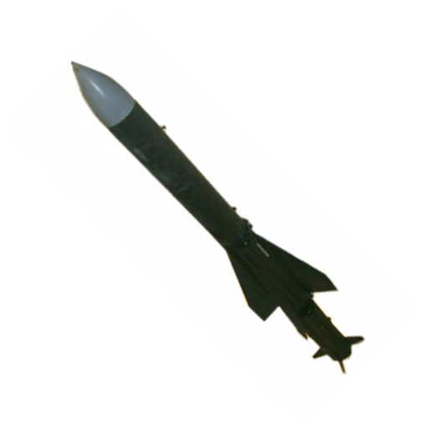
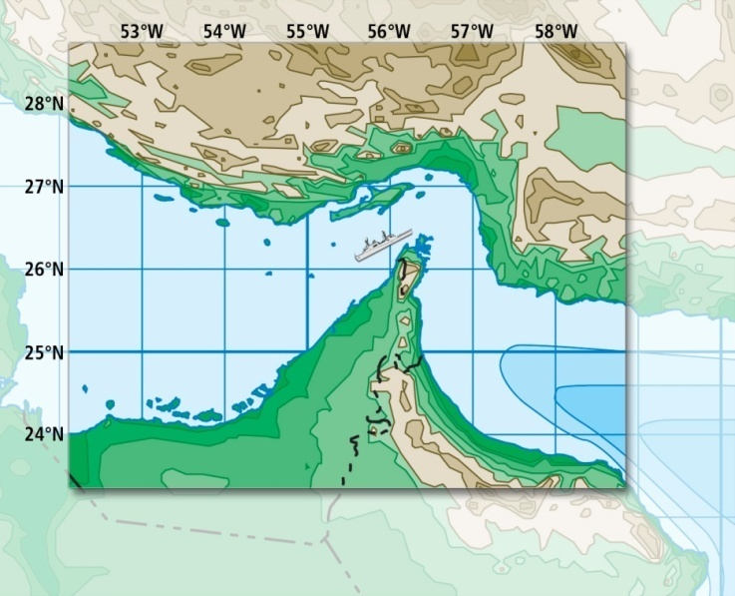
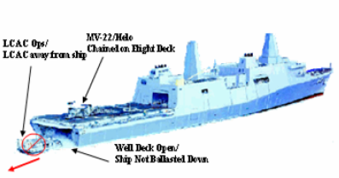
Background
Current PRA methodology is:
  Operationally relevant
  Accepted and Established
  Oriented solely to calculate a single value (P_{RA})
  Ideal candidate for in-depth DOE
T1R1 - sea-skimming, subsonic RF threat
T2 - sea-skimming, subsonic Imaging IR threat
T5 - high diver, supersonic RF ARM threat
T7 - sea-skimming, maneuvering supersonic Advanced RF Threat
Scenario
“Clean”
and
“Dirty”
Signatures
Littoral Scenario
AVW Technologies, Inc
Notes:
Operational context is key and can’t change.

Slide 6
Background and Challenges
Run Reduction Strategy for LPD 17 based on rudimentary application of DOE.
Historical analysis was attempted for LPD 17 data by AVW and DOT&E.
  No surprising insights resulted
Lessons learned:
  Categorized variables like radial are difficult to analyze, since they are not continuous.
  Binary outcomes are even more difficult to analyze because there is no conventional way to calculate variance & other statistical parameters.
Necessitates a more in-depth approach to find confounding factors and their interrelationships.
AVW Technologies, Inc
Notes:
Tom Kramer from IDA presents his findings tomorrow during the classified session.

Slide 7
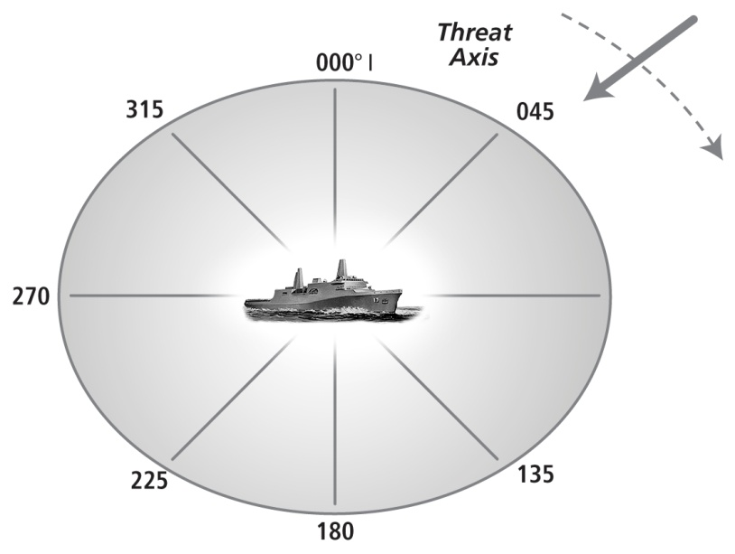
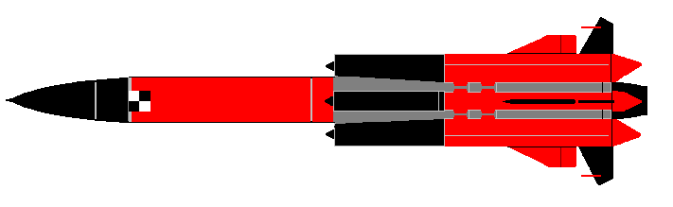

Additional Challenges
Difficult to identify ‘specific factors’ in particular scenarios
  Requires runs to investigate
Each scenario (radial, TOD, etc.) has a confluence of factors
Example--different radials vary the following:
  RF propagation for ship sensors (duct strength, height)
  RF clutter for ship radars
  (land, wave direction)
  Ship radar blockage
  RF propagation for threat seeker
  Ship RCS/Decoy effectiveness
  IR scene for RAM
  Wind
  Threat spacing in bearing and distance
AVW Technologies, Inc

Slide 8
Example: Environment Categorization
Empirical way to quantify input factors
  Each radial would include a parameter for RF prop, clutter, IR scene, RCS, threat separation
  Categorize each parameter:
    +1 favorable conditions
    0 neutral conditions
    -1 adverse conditions
Ultimate goal is to eliminate test cases.
AVW Technologies, Inc
Notes:
Experiments can lead to understanding which factors are important and which are not.

Slide 9
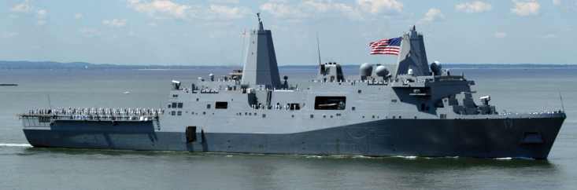
Scoring
Analytical way to quantify outcomes
  Miss distance
  Aimpoint errors
  Scoring related to ship (vulnerability)
AVW Technologies, Inc
Notes:
Gets around binary scoring problem.

Slide 10
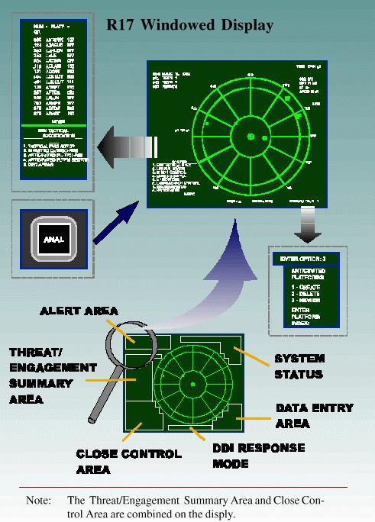
Non-Determinism
Demonstrated differing outcomes given identical scenarios during DT5.
Attributable to the way tactical software operates.
Is there a minimum number of trials required to give a statistically significant outcome?
  Would require a large number of runs for each scenario
  OR
Treat each scenario as we do in real ships—any given event can go many different ways
AVW Technologies, Inc

Slide 11
Basic Steps
Identify factors
Establish types and levels for each factor
Assign factor levels to each scenario
Identify, execute and analyze screening runs
Develop formalized run matrix
Execute runs
Analyze results
Refine formalized run matrix
  based on identified relevant
  factors
AVW Technologies, Inc

Slide 12
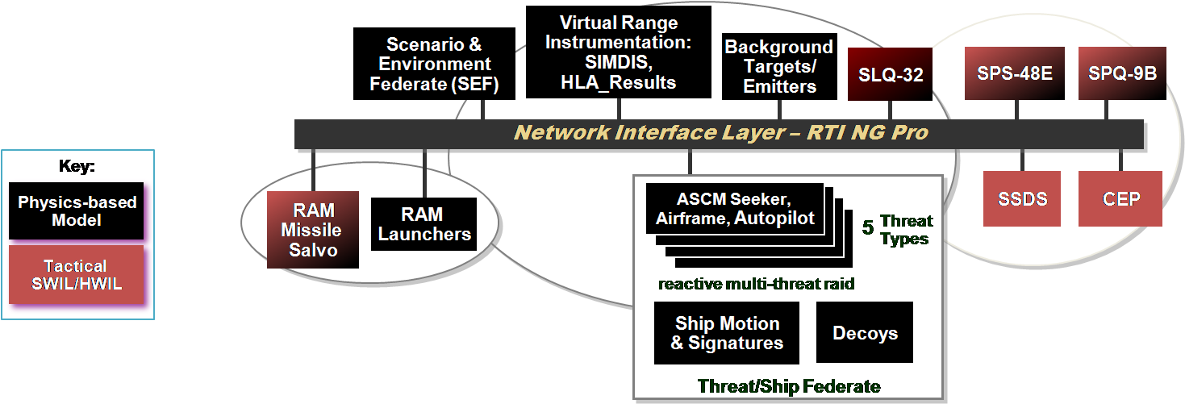
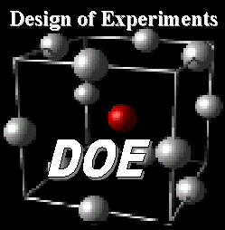
Bottom Lines
DOE is a natural complement to ongoing V&V process
Gain value from Testbed runs during DTs (maximizing resource investment)
Analytical insight into Combat Systems performance and factors influencing engagement outcomes
Defendable approach to Testbed runs—to complement COTF’s methodology
Test
Analyze
AVW Technologies, Inc

Slide 13
Design of Experiments and the Probability of Raid Annihilation (P_{RA}) Testbed
860 Greenbrier Circle
Suite 305
Chesapeake, VA 23320
www.avwtech.com
Phone:
757-361-9581
Fax:
757-361-9585
AVW Technologies, Inc

