Slide 1
Expanded Use of the Probability of Raid Annihilation (P_{RA}) Testbed
Presenter: Richard Lawrence
860 Greenbrier Circle
Suite 305
Chesapeake, VA 23320
www.avwtech.com
Phone:
757-361-9581
Fax:
757-361-9585
AVW Technologies, Inc

Slide 2
Expanded Use of the Probability of
Raid Annihilation (P_{RA}) Testbed
Introduction
The P_{RA} testbed support to LPD-17 is complete, but the testbed itself is just maturing into a multi-use toolset . This toolset has possibilities of supporting other test events/systems outside of the confines of the current planned events. In order to realize and capitalize on the engineering research, development and subsequent refinements in the testbed it is well worth exploring all potential avenues for employing this federation of models.
Presentation Outline
P_{RA} and the Enterprise
Capitalization
Areas for Expansion
Fleet Tactics Development
S/W Validation
SSTAMDA vs AAW CRD
Trade Studies
Evolving Capabilities and Threats
Predictive Analysis
Conclusion
AVW Technologies, Inc

Slide 3
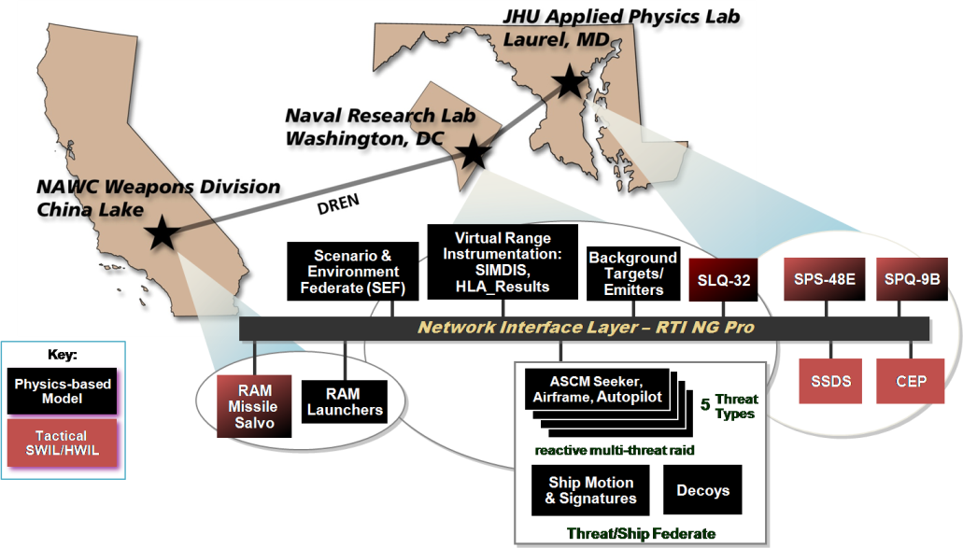
P_{RA} and the ENTERPRISE
Probability of Raid Annihilation (P_{RA}) Testbed forms one of the core elements of the Enterprise Approach to Anti-Air Warfare Ship Self Defense (AAW SSD).
Proven capability to provide answers for LPD 17 AAW SSD MOE and other Enterprise platforms/systems.
Capability exists to answer other questions, to expand the use of the testbed.
Fleet Tactics
Trade Studies
SSTAMDA
S/W Release
Validation
Predictive Analysis
Evolving Capabilities and Threats
Future Upgrade/Expansion – Capitalize on today’s foundation
AVW Technologies, Inc

Slide 4
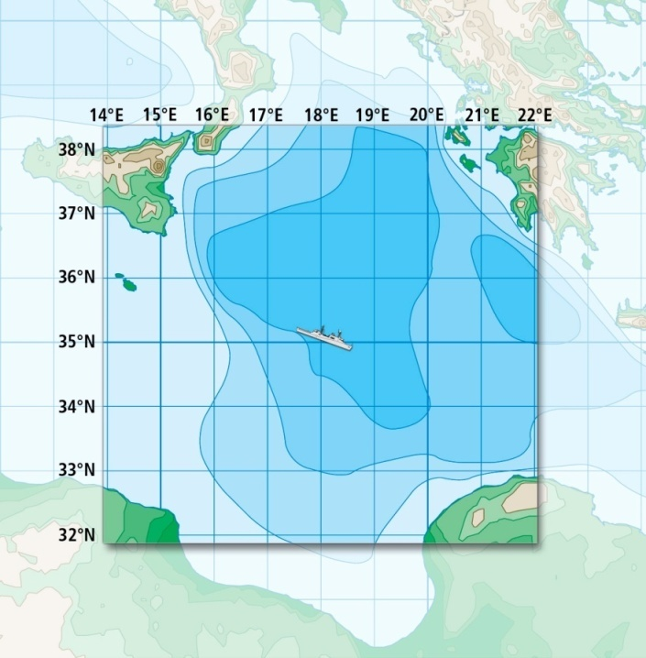
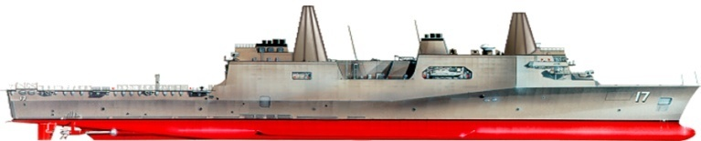
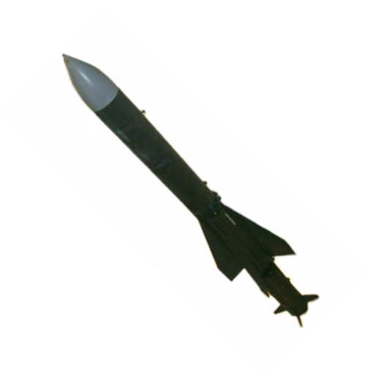
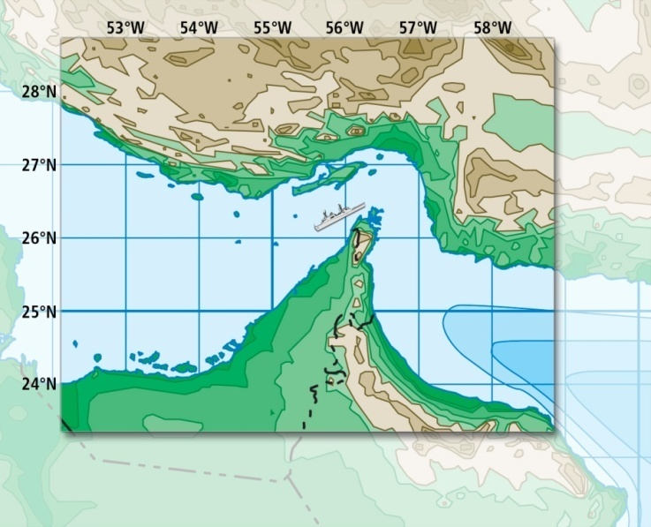
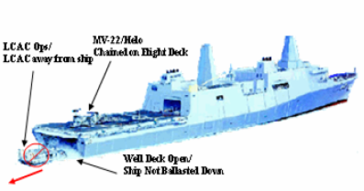
Capitalization
Capitalize on engineering research & development completed to date:
  Operationally relevant environments
  Common/shared geographies, threats, and weapons
  Sensor performance
  Common Lethality Federate (CLF)*
T1R1 - sea-skimming, subsonic RF threat
T2 - sea-skimming, subsonic Imaging IR threat
T5 - high diver, supersonic RF ARM threat
T7 - sea-skimming, maneuvering supersonic Advanced RF Threat
Scenario
“Clean”
and
“Dirty”
Signatures
Littoral Scenario
AVW Technologies, Inc

Slide 5
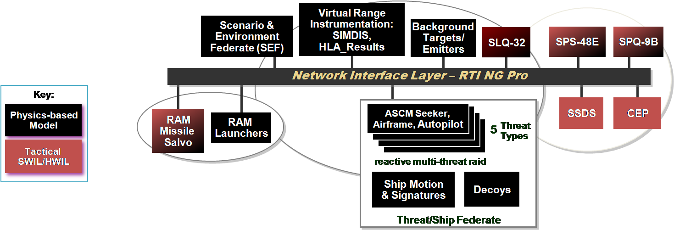
Areas for Expansion
Six Preliminary Areas for consideration in Testbed Expansion
These areas represent beginning possibilities.
As other testbeds are developed, co-use opportunities arise – example is DDG 1000 MOE Testbed.
Fleet Tactics
Trade Studies
SSTAMDA
S/W Release
Validation
Predictive Analysis
Evolving Capabilities and Threats
AVW Technologies, Inc

Slide 6
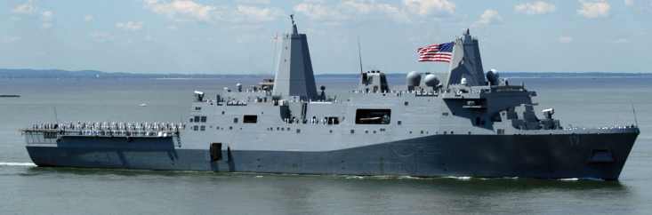
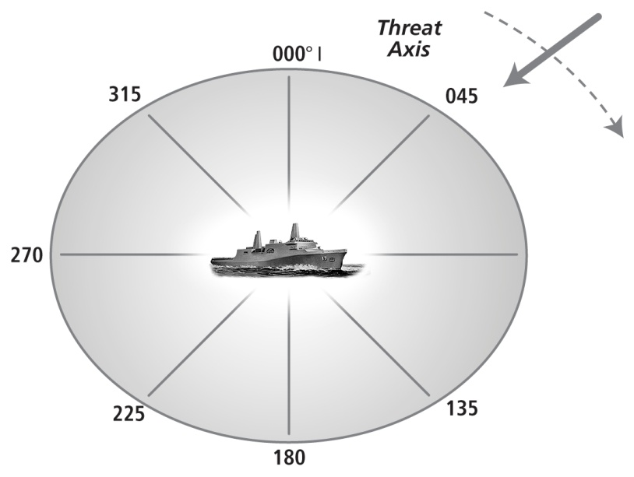
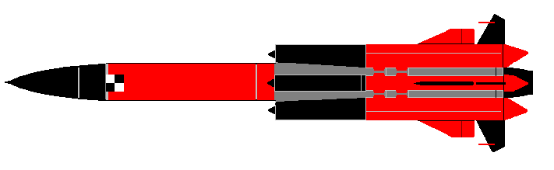

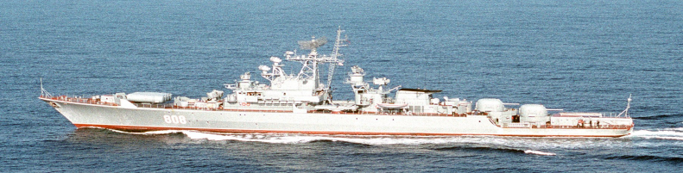
Fleet Tactics Development
Fleet Tactics
  Currently developed using intelligence, threat assessments, M&S, and tactician analysis validated by limited, if any, formal live end-to-end test events.
  Testbed can used to verify interim and experimental tactics techniques and procedures against hi-fi representations of appropriate threats.
  Ability to develop and verify tactics via modeling and simulations (M&S) affords the opportunity to vary the tactical environment.
AVW Technologies, Inc

Slide 7
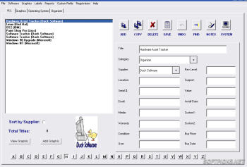
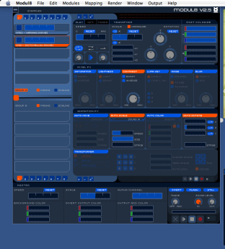
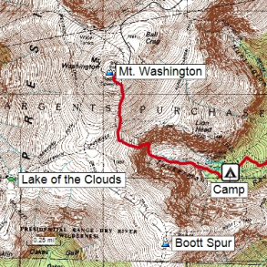
S/W Validation
Validation of Software Releases
  Testbed could be used to test and validate tactical software updates, thereby eliminating the need to test and retest on fleet units or test facilities.
    Ties up fleet assets
    Scarce test resources
  An invaluable tool to mitigate time and costs
  Saves test resource usage
Test
Analyze
Fix
Evaluate
AVW Technologies, Inc

Slide 8

SSTAMDA VS AAW CRD
SSTAMDA imposes P_{RA} requirements on future ship classes & and existing ships with significant combat system upgrades.
Recommended P_{RA} for existing ship classes are different from AAW CRD.
Future ship classes are required to demonstrate they meet the new P_{RA.}
  The Testbed easily adaptable to test virtual ship against the new requirements.
SSTAMDA
New Requirements tested in a Proven Fashion
AVW Technologies, Inc

Slide 9
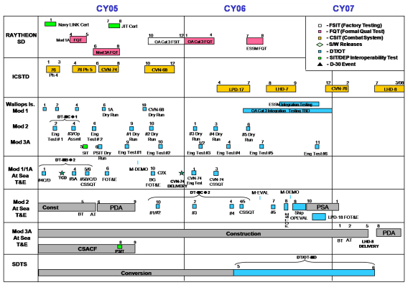
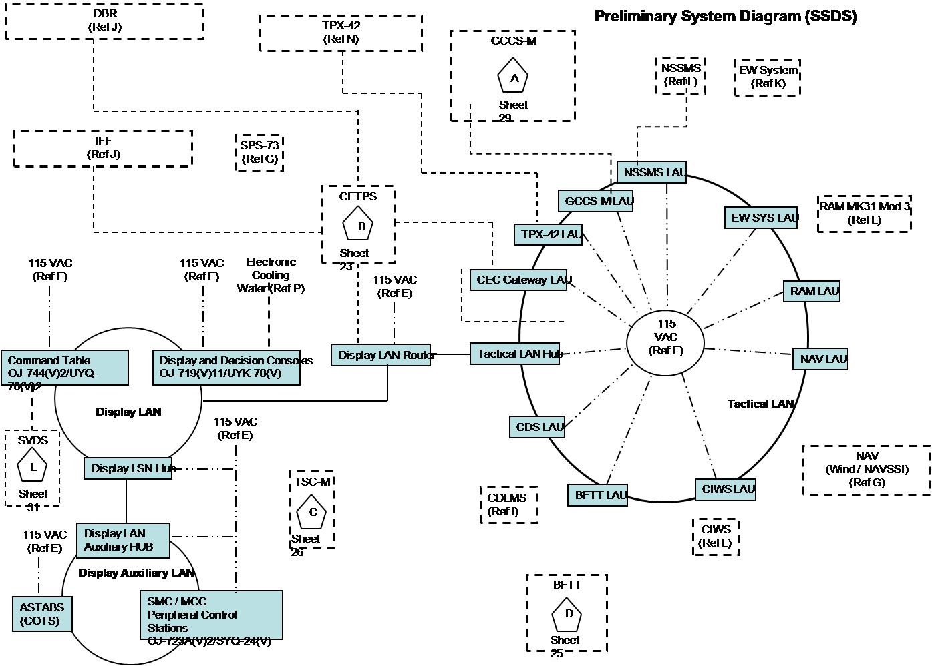
Trade Studies
Use of the Enterprise Testbed to determine:
  If a particular combat system configuration will perform successfully to meet P_{RA} requirements.
  Efficacy of future ship class combat systems variations investigated to an increased degree of accuracy.
    Prior to full funding commitment or design.
    Cost saver.
Cost
Schedule
Capability
AVW Technologies, Inc

Slide 10
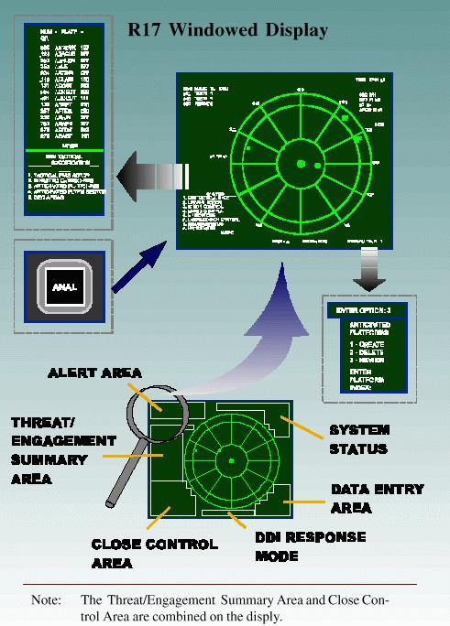
Evolving Capabilities and Threats
Testing combat systems against evolving threats:
  With low probability of intercept radars.
  With coherent radars.
  With low observable technologies.
Navy’s advancement with (SEWIP) Block II AN/SLQ-32 B, will require:
  Higher fidelity emissions from threat surrogates (targets) and threat models.
Use of the Testbed would realize cost savings and fill shortcomings imposed by a lack of capable targets.
AVW Technologies, Inc

Slide 11

Predictive Analysis
Changes/updates to the appropriate model(s) in the Testbed would facilitate a sufficient number of Monte-Carlo’ed scenarios for pre-flight prediction.
Provides ability to craft and run a number of scenarios to find the heart of & limits of the test envelope.
Combine with Design of Experiments to define the test space and number of live events to achieve statistically significant results.
Test
Analyze
AVW Technologies, Inc

Slide 12
Expanded Use of the Probability of Raid Annihilation (P_{RA}) Testbed
Conclusion
Capability exists to answer other questions, to expand the use of the testbed.
The initial development is complete and proven through the LPD 17 P_{RA} effort.
A variety of efforts would benefit from a complementary M&S input:
Fleet TTP
Software validation
SSTAMDA
Trade Studies
Evolving Capabilities and Threats
Predictive Analysis
AVW Technologies, Inc

Slide 13
Expanded Use of the Probability of Raid Annihilation (P_{RA}) Testbed
860 Greenbrier Circle
Suite 305
Chesapeake, VA 23320
www.avwtech.com
Phone:
757-361-9581
Fax:
757-361-9585
AVW Technologies, Inc

